Slide 1
WiE WSF TSC WL Performance Glibc-bench in TDX -Security
Tao shaoyu
July 21, 2022

Slide 2
Agenda
Brief introduction
Glibc-bench
TDX performance drop
System Configuration
Workload
Performance Data
Test cases and KPI
Performance comparison: Legacy VM vs Bare metal
Performance comparison: TDVM vs Legacy VM
Conclusion & Next Steps
2

Slide 3
Glibc-bench
What is “glibc-bench”
Used to measure the performance of glibc APIs
Multi instruction sets performance comparison
For X86 Arch: SSE, AVX2, AVX512…
Full test suite ( glibc v2.35 ) include
6 categories: memory malloc, math, multi-threads, memory copy / set, …
188 binary files
80 output files
> 290,000 test result items
3

Slide 4
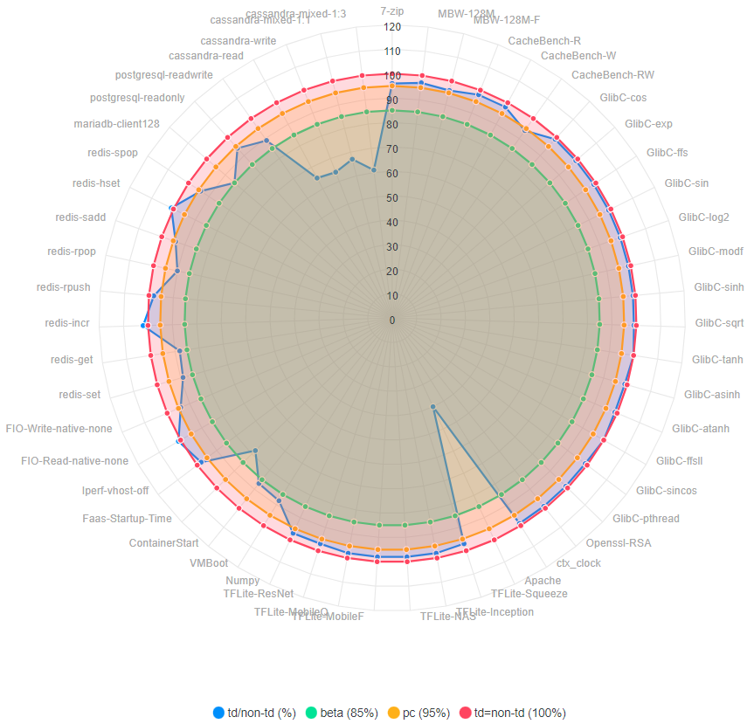
TDX performance drop
What is TDX?
To provide hardware-isolated, confidential VMs ( Trust Domain )
Mainly base on two technologies:
VMX extensions
MKTME
Known performance drop
> 90% WLs, TDVM performance close to legacy VM
< 10% WLs, TDVM performance drop obviously
Performance report from TDX MVP Stack Release team
https://wiki.ith.intel.com/display/csecss/Performance
4
Notes:
http://cpio-devops-pub.sh.intel.com/tdx/tdx_spr_perf.html

Slide 5
System Configuration
Name | SPR97623 | Legacy VM | TDVM
Manufacturer | Intel Corporation | Intel Corporation | Intel Corporation
Product Name | ArcherCity | ArcherCity | ArcherCity
BIOS Version | EGSDCRB1.86B.0078.D27.2204181335 | EGSDCRB1.86B.0078.D27.2204181335 | EGSDCRB1.86B.0078.D27.2204181335
OS | CentOS Stream 8 | CentOS 8 | CentOS 8
Kernel | 5.15.0-spr.bkc.pc.5.12.0.x86_64 | 5.15.0-spr.bkc.pc.3.16.0.x86_64 | 5.15.0-spr.bkc.pc.3.16.0.x86_64
IRQ Balance | Enabled | Enabled | Enabled
CPU Model | Genuine Intel(R) CPU 0000%@ - Q03J | Genuine Intel(R) CPU 0000%@ - Q03J | Genuine Intel(R) CPU 0000%@ - Q03J
Base Frequency | 1.6GHz | 1.6GHz | 1.6GHz
Maximum Frequency | 3.5GHz | 3.5GHz | 3.5GHz
All-core Maximum Frequency | 2.6GHz | 2.6GHz | 2.6GHz
CPU(s) | 240 | 16 | 16
Thread(s) per Core | 2 | 2 | 2
Core(s) per Socket | 60 | 16 | 16
Socket(s) | 2 | 1 | 1
NUMA Node(s) | 2 | 1 | 1
L3 Cache | 115200K | 115200K | 115200K
Prefetchers | DCU IP, L2 HW, L2 Adj. | DCU IP, L2 HW, L2 Adj. | DCU IP, L2 HW, L2 Adj.
Turbo | Enabled | Enabled | Enabled
PPIN(s) | 5df94908a5e86db4 | 5df94908a5e86db4 | 5df94908a5e86db4
Power & Perf Policy | Performance | Performance | Performance
TDP | 350 watts | 350 watts | 350 watts
Frequency Driver | intel_pstate | intel_pstate | intel_pstate
Frequency Governer | performance | performance | performance
Frequency (MHz) | 1600 | 1600 | 1600
Max C-State | 9 | 9 | 9
Installed Memory | 512GB (16x32GB DDR5 4800MT/s [4800MT/s]) | 32GB | 32GB
Huge Pages Size | 1048576 kB | No | No
Transparent Huge Pages | always | always | always
Automatic NUMA Balancing | Enabled | Enabled | Enabled
TDX |  | Disable | Enable
5

Slide 6
Performance Data: Test cases and KPI
categories | Case name | Runtime threads | core bind scheme
Memory copy / set | memset_erms-length_131072 | 1 | 4
 | memset_avx512_unaligned-length_131072 | 1 | 4
 | memcpy_erms-length_33554439 | 1 | 4
 | memcpy_avx512_unaligned_erms-length_33554439 | 1 | 4
stdlib | sprintf_positional_mean | 1 | 4
Math | acos | 1 | 4
 | asinh | 1 | 4
 | exp | 1 | 4
 | log2 | 1 | 4
 | sqrt | 1 | 4
Memory malloc | malloc_time_per_iteration | 8 | 4-11
Multi-threads | thread_create-stack=2048,guard=1 | 32 | 4-11
 | malloc_main_arena_st_allocs_1600_time | 3 | 4-7
 | malloc_main_arena_mt_allocs_1600_time | 3 | 4-7
 | malloc_thread_arena__allocs_1600_time | 3 | 4-7
Runtime parameters
Comand: numactl -m 0 -N 0 -C {core-bind-scheme}
Detailed test rules
Run 20 rounds per case, take the median value as the final value
KPI Definition
average run time = Difference of Time Stamp Counter (TSC)
6

Slide 7
Performance Data: Legacy VM vs BM
Case name | Bare metal |  | Legacy VM
 | cv | Median( LIB ) | cv | Median (LIB) | Legacy VM / BM
memset_erms-length_131072 | 0.0119 | 5,136.09 | 0.043012 | 5,095.01 | 0.99162203
memset_avx512_unaligned-length_131072 | 0.000293 | 3,977.71 | 0.031209 | 3,986.38 | 1.00309601
memcpy_erms-length_33554439 | 0.012991 | 3,344,110.00 | 0.009298 | 3,348,320.00 | 0.99195302
memcpy_avx512_unaligned_erms-length_33554439 | 0.000632 | 3,058,605.00 | 0.000683 | 2,897,400.00 | 0.9470167
sprintf_positional_mean | 0.003317 | 592.88 | 0.012621 | 603.76 | 1.01833767
acos | 0.002891 | 8.76 | 0.002922 | 8.84 | 1.00752786
asinh | 0.00059 | 10.92 | 0.000533 | 11.04 | 1.01115356
exp | 0.017814 | 8.54 | 0.023583 | 8.32 | 0.97742633
log2 | 0.00194 | 8.80 | 0.002428 | 8.79 | 1.00130518
sqrt | 0.00043 | 2.77 | 0.000491 | 2.81 | 1.01167702
malloc_time_per_iteration | 0.006676 | 23.72 | 0.008055 | 23.25 | 0.98582466
thread_create-stack=2048,guard=1 | 0.093111 | 1,001,155.00 | 0.145382 | 866,484.00 | 0.86165079
malloc_main_arena_st_allocs_1600_time | 0.012277 | 1,415.21 | 0.018404 | 1,473.47 | 1.02249843
malloc_main_arena_mt_allocs_1600_time | 0.009721 | 1,454.47 | 0.012492 | 1,503.58 | 1.00934705
malloc_thread_arena__allocs_1600_time | 0.012116 | 1,442.24 | 0.014721 | 1,473.86 | 1.0257413
Performance 计算公式： A/B，=1 表示性能接近，<1 表示性能更优
For most cases, legacy VM has no significant performance drop relative to BM
For the case “thread_create”, the performance of legacy VM is better than BM
改小数位数3位，CV 用百分号
7

Slide 8
Performance Data: TDVM vs Legacy VM
Case name | Legacy VM |  | TDVM
 | cv | Median( LIB ) | cv | Median (LIB) | TDVM / Legacy VM
memset_erms-length_131072 | 0.043012 | 5,095.01 | 0.022506 | 5,286.71 | 1.038021347
memset_avx512_unaligned-length_131072 | 0.031209 | 3,986.38 | 0.015235 | 4,080.27 | 1.022617681
memcpy_erms-length_33554439 | 0.009298 | 3,348,320.00 | 0.008581 | 3,395,840.00 | 1.023706741
memcpy_avx512_unaligned_erms-length_33554439 | 0.000683 | 2,897,400.00 | 0.001379 | 3,018,430.00 | 1.042077644
sprintf_positional_mean | 0.012621 | 603.76 | 0.007338 | 627.67 | 1.039623188
acos | 0.002922 | 8.84 | 0.002349 | 9.05 | 1.024657339
asinh | 0.000533 | 11.04 | 0.000838 | 11.30 | 1.023492532
exp | 0.023583 | 8.32 | 0.014684 | 8.62 | 1.032750885
log2 | 0.002428 | 8.79 | 0.00491 | 9.03 | 1.024303684
sqrt | 0.000491 | 2.81 | 0.000849 | 2.87 | 1.021949855
malloc_time_per_iteration | 0.008055 | 23.25 | 0.012388 | 23.98 | 1.025582683
thread_create-stack=2048,guard=1 | 0.145382 | 866,484.00 | 0.070646 | 1,615,160.00 | 1.872332336
malloc_main_arena_st_allocs_1600_time | 0.018404 | 1,473.47 | 0.013762 | 1,501.83 | 1.037852873
malloc_main_arena_mt_allocs_1600_time | 0.012492 | 1,503.58 | 0.013519 | 1,533.01 | 1.044235099
malloc_thread_arena__allocs_1600_time | 0.014721 | 1,473.86 | 0.012474 | 1,534.55 | 1.037303293
Performance 计算公式： A/B，=1 表示性能接近，<1 表示性能更优
For most cases, TDVM has no significant performance drop relative to legacy VM
For the case “thread_create”, when running in TDVM, there is a significant drop
8

Slide 9
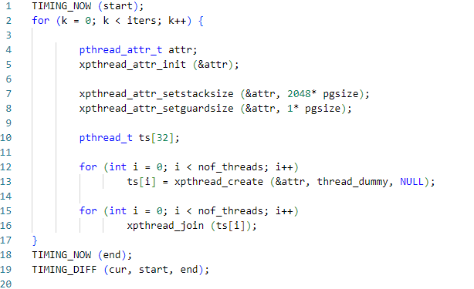
Performance Data: Analysis 1
 | nof_bindcore=1 |  | nof_bindcore=4 |  | nof_bindcore=8
nof_threads | median |  | median |  | median
4 | 52,347.55 |  | 99,032.05 |  | 102,473.00
8 | 138,584.00 |  | 220,246.00 |  | 232,641.00
12 | 226,708.50 |  | 347,155.50 |  | 360,995.00
16 | 314,668.50 |  | 473,527.00 |  | 489,675.50
20 | 406,371.50 |  | 596,557.50 |  | 616,779.50
24 | 498,563.50 |  | 729,188.50 |  | 735,166.50
28 | 597,434.00 |  | 845,836.50 |  | 876,417.50
32 | 695,308.00 |  | 975,660.00 |  | 1,007,395.00
9

Slide 10
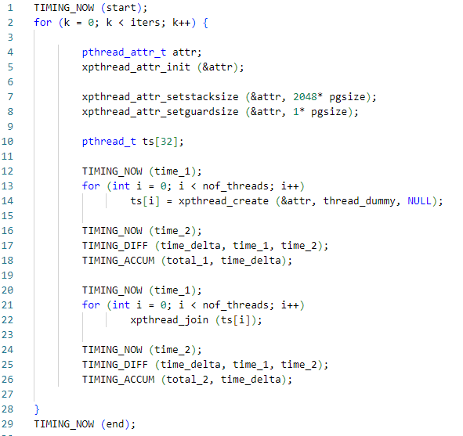
Performance Data: Analysis 2
10

Slide 11
Performance Data: Analysis 3
 | nof_bindcore=1 |  | nof_bindcore=4 |  | nof_bindcore=8
nof_threads | median |  | median |  | median
4 | 52,347.55 |  | 99,032.05 |  | 102,473.00
8 | 138,584.00 |  | 220,246.00 |  | 232,641.00
12 | 226,708.50 |  | 347,155.50 |  | 360,995.00
16 | 314,668.50 |  | 473,527.00 |  | 489,675.50
20 | 406,371.50 |  | 596,557.50 |  | 616,779.50
24 | 498,563.50 |  | 729,188.50 |  | 735,166.50
28 | 597,434.00 |  | 845,836.50 |  | 876,417.50
32 | 695,308.00 |  | 975,660.00 |  | 1,007,395.00
11

Slide 12
Conclusion & Next Steps
Conclusion:
Either compute-intensive or memory-intensive operations, TDVM has no significant performance drop compared to Legacy VM
In multi-process switching scenarios, TDVM performance drops about 40%
Next step:
Research the root cause of the performance drop
12

Slide 13

Photo Example On Lower Half
Thank You
13

